Slide 1
Pioneers in Management

Slide 2
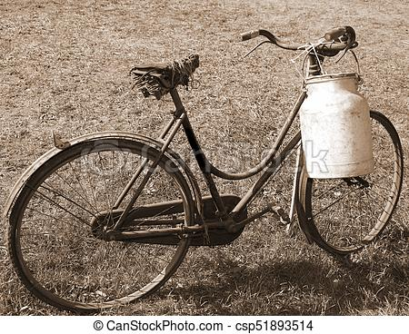

Industrial Revolution late 1700s – late 1800s
Industry = Work
Revolution= Rapid change
From Farm to Factories
From small shops to large Companies

Slide 3
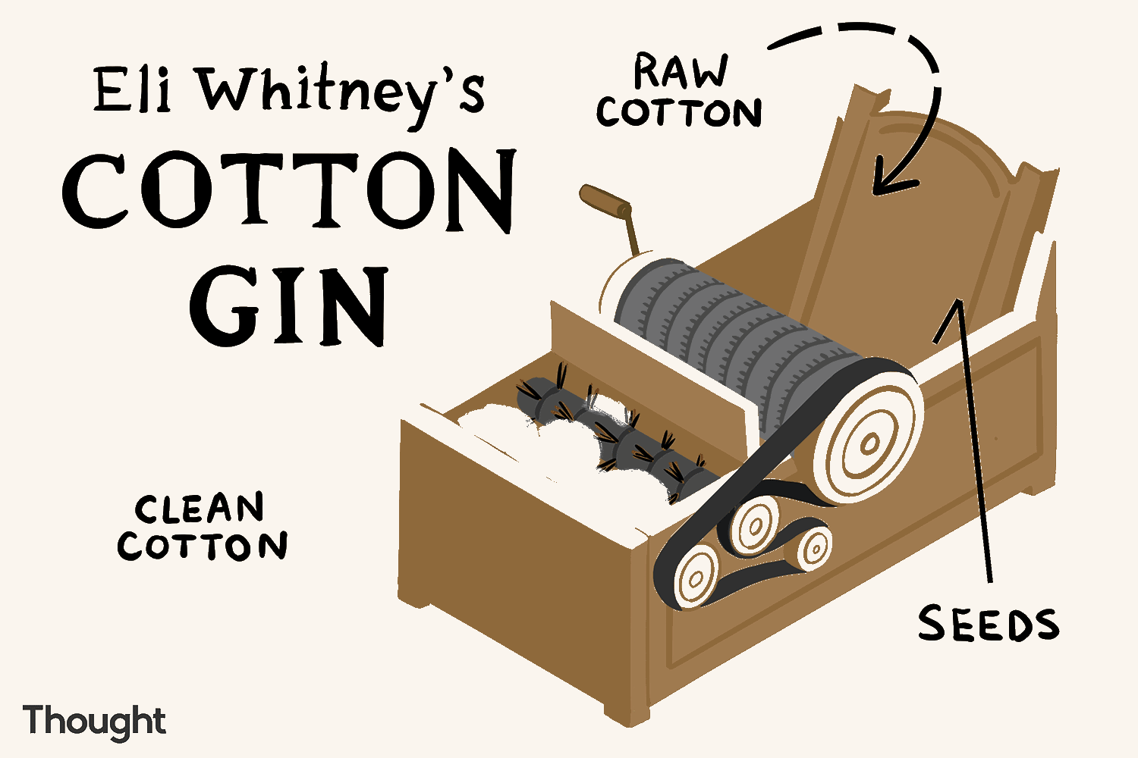
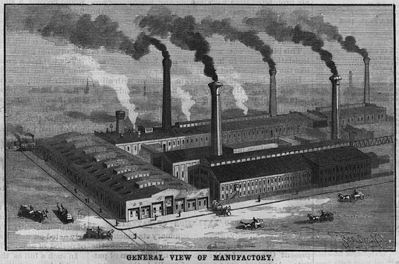
KEY INGREDIENTS
POWER
MACHINARY INNOVATION
TRANSPORTATION

Slide 4
EMERGING ISSUES
Large groups working together
People working alongside Machinery
Increasing pace of Industry
Companies were looking for answers
How are we going to organize all of this ?
How are we going to maximize productivity ?
How are we going to manage all of these people ?

Slide 5
Frederick Taylor (Scientific Management) (1856-1919)
Mechanical Engineer and management consultant
Factories were springing up everywhere and standardized ways did not yet exist to manage large groups of people and handle increasingly complex work
Taylor wanted to make organizations more standardized, efficient and productive by studying their work process closely

Slide 6
Scientific Management
Applying Science to work = Studying tasks carefully and systematically at the micro level to speed up work
Managers earlier followed – “Rule of Thumb”
So Scientific management was proposed- applying standardized methods and tools to increase the output, quality, and reduce costs and wastages
Knowing exactly what you want men to do and seeing that they do it in the best & cheapest way

Slide 7
Principles of Scientific Management
Science not “rule of thumb”
Discards rule of thumb
Advocates Scientific approach
Steps Involved :
Investigation of traditional methods
Unifying the best practices
Developing a standard method
Selecting “one best method” – saves time, effort, money & resources

Slide 8
Principles of Scientific Management
Harmony not discord
There should be complete harmony between the management and workers
Complete mental revolution on the part of both management & workers
Management - share the gains of the company - worker. workers - should work hard – improve business

Slide 9
Principles of Scientific Management
Cooperation, Not Individualism
Cooperation between the labour and the management
Competition should be replaced by cooperation
Constructive suggestions made by the employees should not be ignored & rewarded
Equal division of work and responsibility between workers & management

Slide 10
Principles of Scientific Management
Development of Each and Every person to his or her Greatest Efficiency
Each person should be scientifically selected – Work assigned should suit his/her physical, mental and intellectual capabilities
Train employees if needed
Training – essential – learn Best Method – ensure efficiency for workers and organization

Slide 11
DIVISION OF LABOUR
Wanted to divide the work process into small, simple and separate steps = Division of Labour
Each step or two was performed by a different person
Financial Aid Advisement Registration Payment Confirmation Add/Drop Codes
Wanted to determine the one best way, a standard to do every part of every task to boost productivity
Finalizing a Semester course Schedule of Courses

Slide 12
